Slide 1
Simplification of CFG
Removal of Useless Symbols
-- Sakshi Surve

Slide 2
Simplification of CFG :
Various languages can efficiently be represented by a context-free grammar.
All the grammar are not always optimized that means the grammar may consist of some extra symbols(non-terminal).
Having extra symbols, unnecessary increase the length of grammar.
Simplification of grammar means reduction of grammar by removing these extra symbols.
Notes:
https://www.javatpoint.com/automata-simplification-of-cfg

Slide 3
In a CFG, may it happen that all the production rules are not needed for derivation of strings
Elimination of such strings is called “Simplification of CFG”
By Simplifying, we remove all the unnecessary, redundant productions while keeping the transformed grammar equivalent to the original one.
Simplified form can remove ambiguity and improve G

Slide 4
The properties of reduced grammar are given below:
Each variable (i.e. non-terminal) and each terminal of G appears in the derivation of some word in L.
Useless Symbols
There should not be any production as X → Y where X and Y are non-terminal.
Unit Productions
If ε is not in the language L then the production X → ε need not be there .
Null Productions

Slide 5
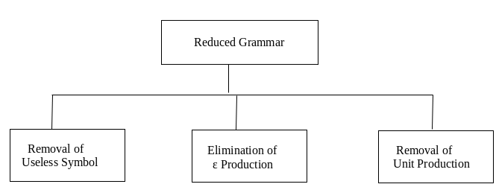
Three ways to Simplify the Grammar :

Slide 6
1. Removal of Useless Symbols :
Useful Symbol (NT) :
Appears on the LHS of the production rule
It generates some terminal symbol
P =>* a
Useless Symbol :
It does not appear on the right-hand side of the production rule (It is not reachable from the start symbol)
It is not live (It doesn’t derive a string )
A production rule is Useless if it involves any Useless Symbols

Slide 7
Steps For reduction of a given grammar G:
Identify Non-generating symbols in the given CFG and eliminate those productions which contains non-generating symbols….Symbols not deriving any string
Identify Non-reachable symbols and eliminate those productions which contain the non-reachable symbols
Notes:
https://www.sanfoundry.com/automata-theory-cfg-eliminating-useless-symbols/

Slide 8
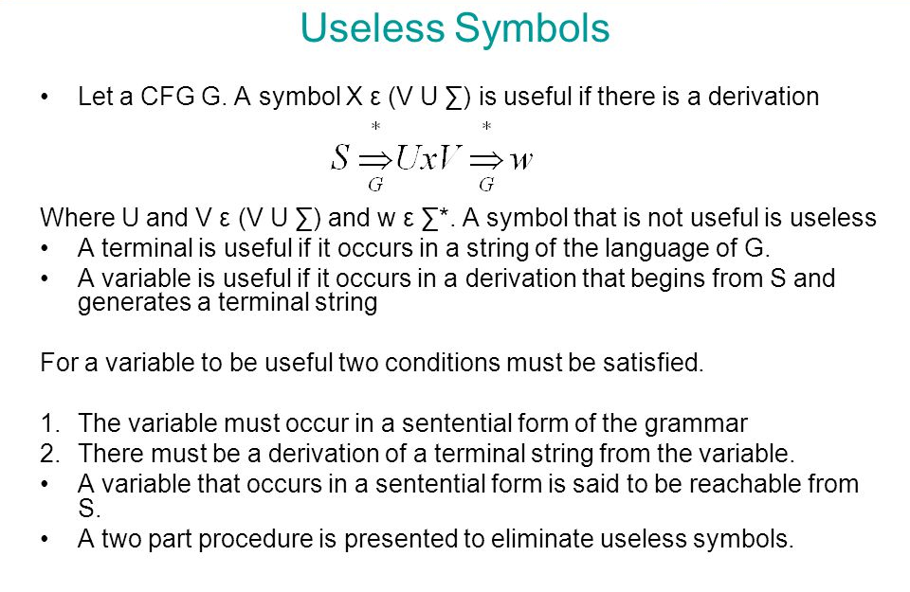

Slide 9
Example 1: Remove the useless symbol from the given context free grammar: S -> aB / bX A -> Bad / bSX / a B -> aSB / bBX X -> SBD / aBx / ad Solution:
A and X directly derive string of terminals a and ad, hence they are useful.
Since X is a useful symbol so S is also a useful symbol as S -> bX.
But B does not derive any string w … so clearly B is a non- generating symbol.
So eliminating those productions with B in them we get S -> bX A -> bSX / a X -> ad
In the reduced grammar A is a non-reachable symbol so we remove it and the final grammar after elimination of the useless symbols is S -> bX X -> ad

Slide 10
The new grammar generates all and only strings generated by the original grammar. Hence it is equivalent to the original grammar.
The equivalent grammar G’ can be represented as :
G’ = ( S, V’, P’, T )
Where
S = S
V ’ = { S, X }
T = { a, b }
P ’ =
{ S -> bX X -> ad
}

Slide 11
Example 2 : Find the equivalent useful grammar from the given grammar A -> xyz / Xyzz X -> Xz / xYz Y -> yYy / Xz Z -> Zy / z Solution :
A and Z is a useful symbol as it can be derived to a string of terminal symbol (Z -> z and A -> xyz).
X and Y are not useful.
So all the production with X and Y in them should be removed to eliminate non-generating symbols.
The grammar then becomes A -> xyz Z -> Zy / z
Since A is the starting symbol this implies Z is the non-reachable symbol.
So we remove it to get a grammar free of useless symbols: A -> xyz

Slide 12
Example 3 : S -> AB/a
A -> BC/b
B -> aB/C
C -> aC/B
Solution:
Symbol B and C are useless symbol, remove them (whole production in which they are present)
So, Useful Symbols: {a, b, S, A} And any combination of useful symbols will also make LHS a useful symbol.
S -> a
A -> b But cause A is not reachable so we will remove A -> b as well, the final production is :
S -> a
Notes:
https://scanftree.com/automata/elimination-of-useless-symbol-from-context-free-grammar

Slide 13
Example 4: S -> AB/AC
A -> aAb/bAa/a
B -> bbA/aaB/AB
C -> abCA/aDb
D -> bD/aC
Solution:
First find out useful Symbols: {a, b, A, B, S}
And useless symbols are: {C, D}
So remove them and write the whole grammar again:
S -> AB
A -> aAb/bAa/a
B -> bbA/aaB/AB

Slide 14
Example 5:
S -> AB | B |a A -> aA B -> b
Solution :
S -> B | a B -> b

Slide 15
Example 6:
S-> abS | abA | abB
A-> cd
B-> aB
C-> dc
Solution :
S-> abS | abA
A-> cd

Slide 16
Example 7:
S-> aAa | aBC
A-> aS | bD
B-> aBa | b
C-> abb | DD
D-> aDa
Solution :
S-> aBC | aAa
A-> aS
B-> aBa | b
C-> abb

Slide 17
Example 8:
T-> aaB | abA | aaT
A-> aA
B-> ab | b
C-> ad
Solution :
T-> aaB | aaT
B-> ab | b

Slide 18
S-> BS | B
A-> aF
B-> b
F-> bB | b
Example 9:
S-> AC | BS | B
A-> aA | aF
B-> CF | b
C-> cC | D
D-> aD | BD | C
E-> aA | BSA
F-> bB | b
Solution :
S-> BS | B
B-> b

Slide 19
Example 10 :
S-> EA
A-> abA | ab
C-> EC | Ab
E -> bC
G-> EbE | CE | ba
Solution :
S-> EA
A-> abA | ab
C-> EC | Ab
E -> bC

Slide 20
After removing the non generating non terminals, the grammar becomes :
S-> aS | A
A-> a
B-> aa
Example 11 :
S-> aS | A | C
A-> a
B-> aa
C-> aCb
Solution :
After removing the non reachable non terminals, the grammar becomes :
S-> aS |A
A-> a

Slide 21
Example 12 :
S-> aA | bB
A-> aA | a
B-> bB
D -> ab | Ea
E-> aE | d
Solution :
S-> aA
A-> aA | a

Slide 22
Example 13 :
S-> AB | CA
A-> a
B-> BC | AB
C -> aB | b
Solution :
S-> CA
A-> a
C->a

Slide 23
Example 14 :
S-> aA | a | Bb | CC
A-> aB
B-> a | Aa
C -> cCD
D-> ddd
Solution :
S-> aA | a | Bb
A-> aB
B-> a | Aa

Slide 24
Three ways to Simplify the Grammar :

Slide 25
Removal of Unit Productions :
The unit productions are the productions in which one non-terminal gives another non-terminal. A->B
Use the following steps to remove unit production:
Step 1: To remove X → Y, add production X → a to the grammar rule whenever Y → a occurs in the grammar. [x ∈ Terminal, x can be Null]
Step 2: Now delete X → Y from the grammar.
Step 3: Repeat step 1 and step 2 until all unit productions are removed.

Slide 26
Example 1 :Remove Unit Productions S → 0A | 1B | C A → 0S | 00 B → 1 | A C → 01
Solution:
S → C is a unit production.
But while removing S → C we have to consider what C gives. So, we can add a rule to S.
S → 0A | 1B | 01
Similarly, B → A is also a unit production so we can modify it as
B → 1 | 0S | 00
Thus finally we can write CFG without unit production as
S → 0A | 1B | 01
A → 0S | 00
B → 1 | 0S | 00
C → 01

Slide 27
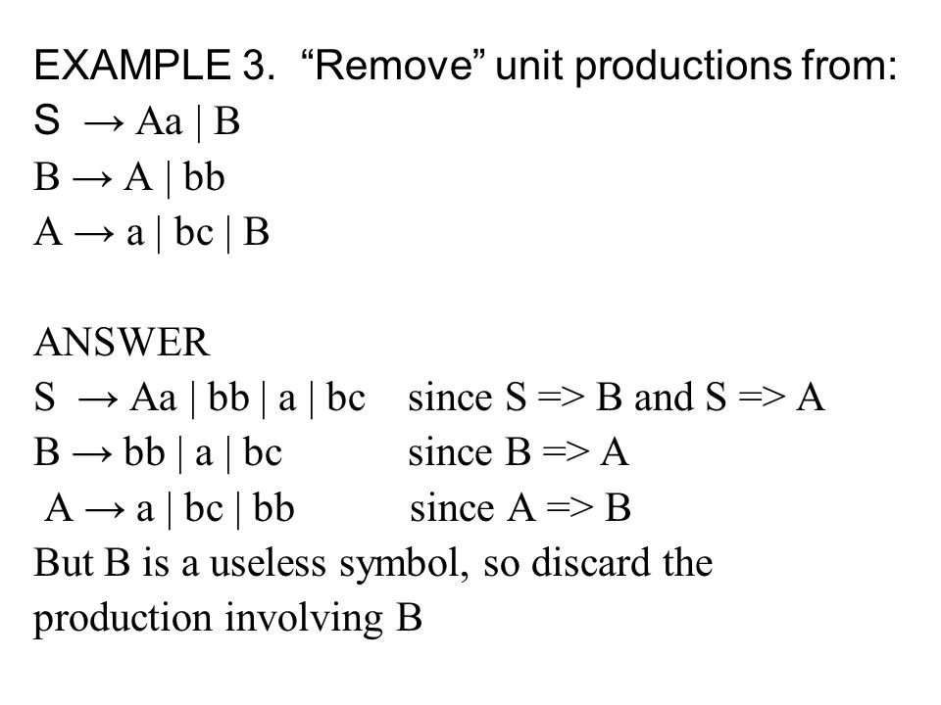

Slide 28
Example 4 : S -> Aa | B A -> b | B B -> A | a Remove Unit Productions
S -> Aa A -> b B -> a Now we find all the variables that satisfy ‘X *=> Z’. These are ‘S *=> A’ , ‘S*=>B’, ‘A *=> B’ and ‘B *=> A’. For ‘A *=> B’ , we add ‘A -> a’ because ‘B ->a’ exists in ‘G’.
Finally we get the following grammar –
S -> Aa | b | a
A -> b | a
B -> a | b
Now remove B -> a|b , since it doesnt occur in the production ‘S’, then the following grammar becomes,
S->Aa|b|a
A->b|a

Slide 29
Example 5 : Consider the following grammar S → M | S + M M → F | M × F F → I | (S) I → a | b | Ia | Ib Remove the Unit Productions

Slide 30
We can remove F → I and add all the productions of I and obtain
I → a | b | Ia | Ib
F → a | b | Ia | Ib | (S)
M → F | M × F
S → M | S + M

Slide 31
S → a | b | Ia | Ib | (S) | M × F | S + M
M → a | b | Ia | Ib | (S) | M × F
F → a | b | Ia | Ib | (S)
I → a | b | Ia | Ib

Slide 32
Example 6 : Simplify the grammar by removing the unit productions from the following grammar S -> AB A -> a B -> C / b C -> D D -> E E -> a

Slide 33
Solution: There are 3 unit production in the grammar B -> C C -> D D -> E For production D -> E there is E -> a so we add D -> a to the grammar and add D -> E from the grammar.
Now we have C -> D so we add a production C -> a to the grammar and
delete C -> D from the grammar.
Similarly we have B -> C by adding B -> a and removing B -> C we get the final
grammar free of unit production as: S -> AB A -> a B -> a / b C -> a D -> a E -> a

Slide 34
We can see that C, D and E are unreachable symbols so to get a completely reduced grammar we remove them from the CFG.
The final CFG is : S -> AB A -> a B -> a / b

Slide 35
Example 7 : S-> S + T | T T-> T * F | F F-> (S) |a
S-> S+T | T*F | (S) | a
T-> T * F | (S) | a
F-> (S) | a

Slide 36
Circular unit production rules
Consider the following grammar
A → B | a
B → C
C → A
Substitutions will run into circular substitutions and will never finish

Slide 37
Simplification (Reduction) of Grammar :
Order of eliminations We must follow the following order of eliminations.
Eliminate epsilon productions
Eliminate unit productions
Eliminate useless symbols

Slide 38
Steps to remove null productions :
Step 1: Look for the Null producions whose right side contains A
Step 2: Replace each occurrence of A in each of these productions with ϵ
Step 3: Now combine the result of step 2 with the original production and remove ε productions.

Slide 39
Removal of Unit Productions :
The unit productions are the productions in which one non-terminal gives another non-terminal. A->B
Use the following steps to remove unit production:
Step 1: To remove X → Y, add production X → a to the grammar rule whenever Y → a occurs in the grammar. [x ∈ Terminal, x can be Null]
Step 2: Now delete X → Y from the grammar.
Step 3: Repeat step 1 and step 2 until all unit productions are removed.

Slide 40
Steps For reduction of a given grammar G:
Identify Non-generating symbols in the given CFG and eliminate those productions which contains non-generating symbols….Symbols not deriving any string
Identify Non-reachable symbols and eliminate those productions which contain the non-reachable symbols
Notes:
https://www.sanfoundry.com/automata-theory-cfg-eliminating-useless-symbols/

Slide 41
Consider the following grammar S→Aa ∣ B B→a ∣ BC C→a ∣ ∈ Simplify the grammar

Slide 42
1.Removal of null production S->Aa|B B->a|B|BC C->a
2.Removal of Unit production S->Aa|a|BC B->a|BC C->a
3.Removal of useless production S->a|BC B->a|BC C->a
G’ = { S, {B , C}, {a} , P’ }

Slide 43
Consider the following grammar S→AC ∣ B A→a C→c ∣ BC E-> aA | e Simplify the grammar

Slide 44
1.Removal of null production There are no Null productions in the given Grammar
2.Removal of Unit production S-> AC
A-> a
C->c
E-> aA | e
3.Removal of useless production S-> AC
A-> a
C-> c
G’ = { S, {A , C}, {a , c} , P’ }

Slide 45
Three ways to Simplify the Grammar :

Slide 46
Removal of Null Symbols :
Null productions are of the form A -> ϵ.
In a given CFG, we call a non-terminal N nullable if there is a production N -> ϵ or there is a derivation that starts at N and leads to ϵ: N => … => ϵ.
We cannot remove all ϵ-productions from a grammar if the language contains ϵ as a word, but if it doesn’t we can remove all.
The removal of ϵ-productions increases the number of rules but reduces the length of derivations.

Slide 47
Steps to remove null productions :
Step 1: Look for the Null producions whose right side contains A
Step 2: Replace each occurrence of A in each of these productions with ϵ
Step 3: Now combine the result of step 2 with the original production and remove ε productions.

Slide 48
If A-> ϵ is a production to be eliminated, then we look for all productions , whose RHS contains A and replace every occurrence of A in each of these productions to obtain Non-ϵ-productions .
The resultant Non- ϵ-productions are added to the original grammar

Slide 49
Example 1 : S-> aA A-> b | ϵ Eliminate ϵ-productions from this grammar
Here, A-> ϵ is a Null Production.
By putting ϵ at the place of A, we get
S-> a
Now, adding this new production to the original grammar
S-> aA
S-> a
A-> b
OR
S-> aA | a
A-> b
This grammar doesn’t contain any ϵ-production

Slide 50
Example 2 : S-> aSa S-> bSb | ϵ Eliminate ϵ-productions from this grammar
Here, S-> ϵ is the epsilon production
So, replacing occurrence of S by epsilon , we get
S-> aa
S-> bb
Adding the new productions to the original grammar , we
get
S-> aSa | aa | bSb | bb

Slide 51
Example 3 : S -> aSb/aAb/ab/a A -> ε
Replace NULL producing symbol with and without in R.H.S. of remaining states And drop the productions which has ε directly.
eg. A -> ε
S -> aSb/aAb/ab/ab/a
But we no need to write "ab" twice So, S -> aSb/aAb/ab/a

Slide 52
Example 4: S -> AB A -> aAA/ε B -> bBB/ε
Nullale Variables are {A, B, S}
Because start state also a Nullable symbol so ε belongs to given CFG
We will proceed with the method:
S -> AB/A/B
A -> aAA/aA/a
B -> bAA/bB/b

Slide 53
Example 5 : Remove the null productions from the following grammar S -> ABAC A -> aA / ϵ B -> bB / ϵ C -> c
We have two null productions in the grammar A -> ϵ and B -> ϵ.
To eliminate A -> ϵ we have to change the productions containing A in the right side.
Those productions are S -> ABAC and A -> aA. So replacing each occurrence of A by ϵ, we get four new productions S -> ABC / BAC / BC A -> a Add these productions to the grammar and eliminate A -> ϵ. S -> ABAC / ABC / BAC / BC A -> aA / a B -> bB / ϵ C -> c

Slide 54
To eliminate B -> ϵ, we have to change the productions containing B on the right side of the newly generated grammar
Doing that we generate these new productions: S -> AAC / AC / C B -> b
Add these productions to the grammar and remove the production B -> ϵ from the grammar.
The new grammar after removal of ϵ – productions is:
S -> ABAC / ABC / BAC / BC / AAC / AC / C A -> aA / a B -> bB / b C -> c

Slide 55
Example 6 : Remove the production from the following CFG by preserving the meaning of it. S → XYX X → 0X | ε Y → 1Y | ε
Now, while removing ε production, we are deleting the rule X → ε and Y → ε. To preserve the meaning of CFG we are actually placing ε at the right-hand side whenever X and Y have appeared.
Let us take
S → XYX
If the first X at right-hand side is ε. Then
S → YX
Similarly if the last X in R.H.S. = ε. Then
S → XY

Slide 56
If Y = ε then
S → XX
If Y and X are ε then,
S → X
If both X are replaced by ε
S → Y
Now,
S → XY | YX | XX | X | Y | ε
Now let us consider
X → 0X
If we place ε at right-hand side for X then,
X → 0
X → 0X | 0

Slide 57
Similarly Y → 1Y | 1
Collectively we can rewrite the CFG with removed ε production as
S → XYX | XY | YX | XX | X | Y | ε
X → 0X | 0
Y → 1Y | 1

